Slide 1
Chapter 2 Software Process Models

Slide 2
Lesson Objectives
Describe and evaluate various software process models
Suggest which process models are appropriate under a given situation of software development

Slide 3
Software Process
Activities to develop software
Software Specification
Software Development
Software Evolution
Software Validation
Basic Activities
Software Product

Slide 4
Software Process
Software process consists of activities, which are involved in developing software products.
Basic activities are:-
Software Specification
Software Development
Software Validation
Software Evolution

Slide 5

Software Process Model
Including:
SW processes
Roles
Products
Simplified description of software processes
Different perspectives

Slide 6
Software Process Model
Software process model is a simplified description of a software process which is presented from a particular perspective.
May include activities which are part of the software process, software products and the roles of people involved in software engineering

Slide 7
Software Process Model
Linear Sequential Model/Waterfall Model
Prototyping Model
Rapid Application Model
Evolutionary Model
Incremental Model
Spiral Model
Component-based Development Model
Agile Software Development
Extreme Programming

Slide 8
1. Linear Sequential Model/Waterfall Model

Slide 9
1. Linear Sequential Model/Waterfall Model
Commonly known as classic life cycle or the waterfall model
Activities include:-
System/information engineering and modeling
Software requirements analysis
Design
Code Generation
Testing
Support
Hardware, people, database
At strategic business level

Slide 10
1. Linear Sequential Model/Waterfall Model
Communication
Project Initiation
Requirement Gathering
Cannot make changes for the previous step
Planning
Estimating
Scheduling
Tracking
Modeling
Analysis
Design
Construction
Code
Test
Deployment
Delivery
Support
Feedback

Slide 11

1. Linear Sequential Model/Waterfall Model
1. Systematic
2. Easy to follow
Advantages

Slide 12
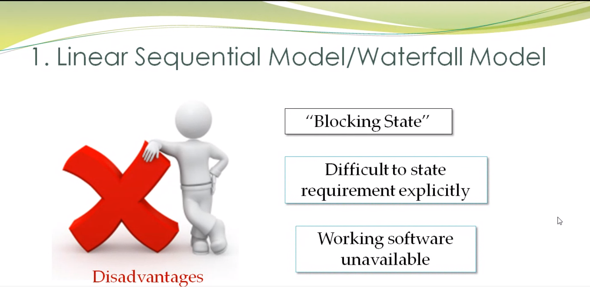

Slide 13

1. Linear Sequential Model/Waterfall Model
What are the drawbacks of this model?
1. “Blocking state” situation - Real projects rarely follow linear flow
2. Difficult for customers to state requirement explicitly
3. Working version of software unavailable until later stage

Slide 14
1. Linear Sequential Model/Waterfall Model
When to use Waterfall approach?
This model is use only when the requirements are very well-known, clear and fixed
Product definition is stable
Technology is understood
There are no ambiguous requirements
Ample resources with required expertise are available freely
The project is short
No requirement changes

Slide 15
2. Prototyping Model

Slide 16

2. Prototyping Model
Software customers and end-users usually find it very difficult to express their real requirements
A system prototype can be developed to give end-users a concrete impression of the system capabilities

Slide 17
2. Prototyping Model
It may therefore help in establishing and validating system requirements and allows the users to experiment with requirements and to see how the system supports their work
It’s a technique of risk reduction (Boehm et al., 1984)

Slide 18

2. Prototyping Model
Customer test drives mock-up
Listen to customer
Build/revise mock-up
Activities

Slide 19

2. Prototyping Model
Communication
Deployment
Delivery & Feedback
Quick Plan
Construction of Prototype
Modeling Quick Design

Slide 20
2. Prototyping Model
Establish prototype objectives
Define prototype f(x)nality
Develop prototype
Evaluate
prototype
Prototyping plan
Outline Definition
Executable prototype
Evaluation report
Is it to:
Prototype UI
validate functional requirement
show feasibility of application

Slide 21
2. Prototyping Model – How to create?
Prototyping techniques include the use of the following: -
Dynamic high-level language development
Fourth-generation languages – e.g. SQL
Prototype construction from reusable components
Visual programming language
Internet-based prototyping

Slide 22
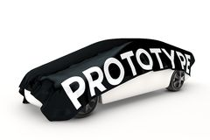
Throwaway vs Evolutionary Prototyping
Prototyping in the software process may involve :
‘Throw-away' prototyping in which a prototype is developed to understand the system requirements, or
Evolutionary prototyping in which a prototype evolves through a number of versions to the final system

Slide 23
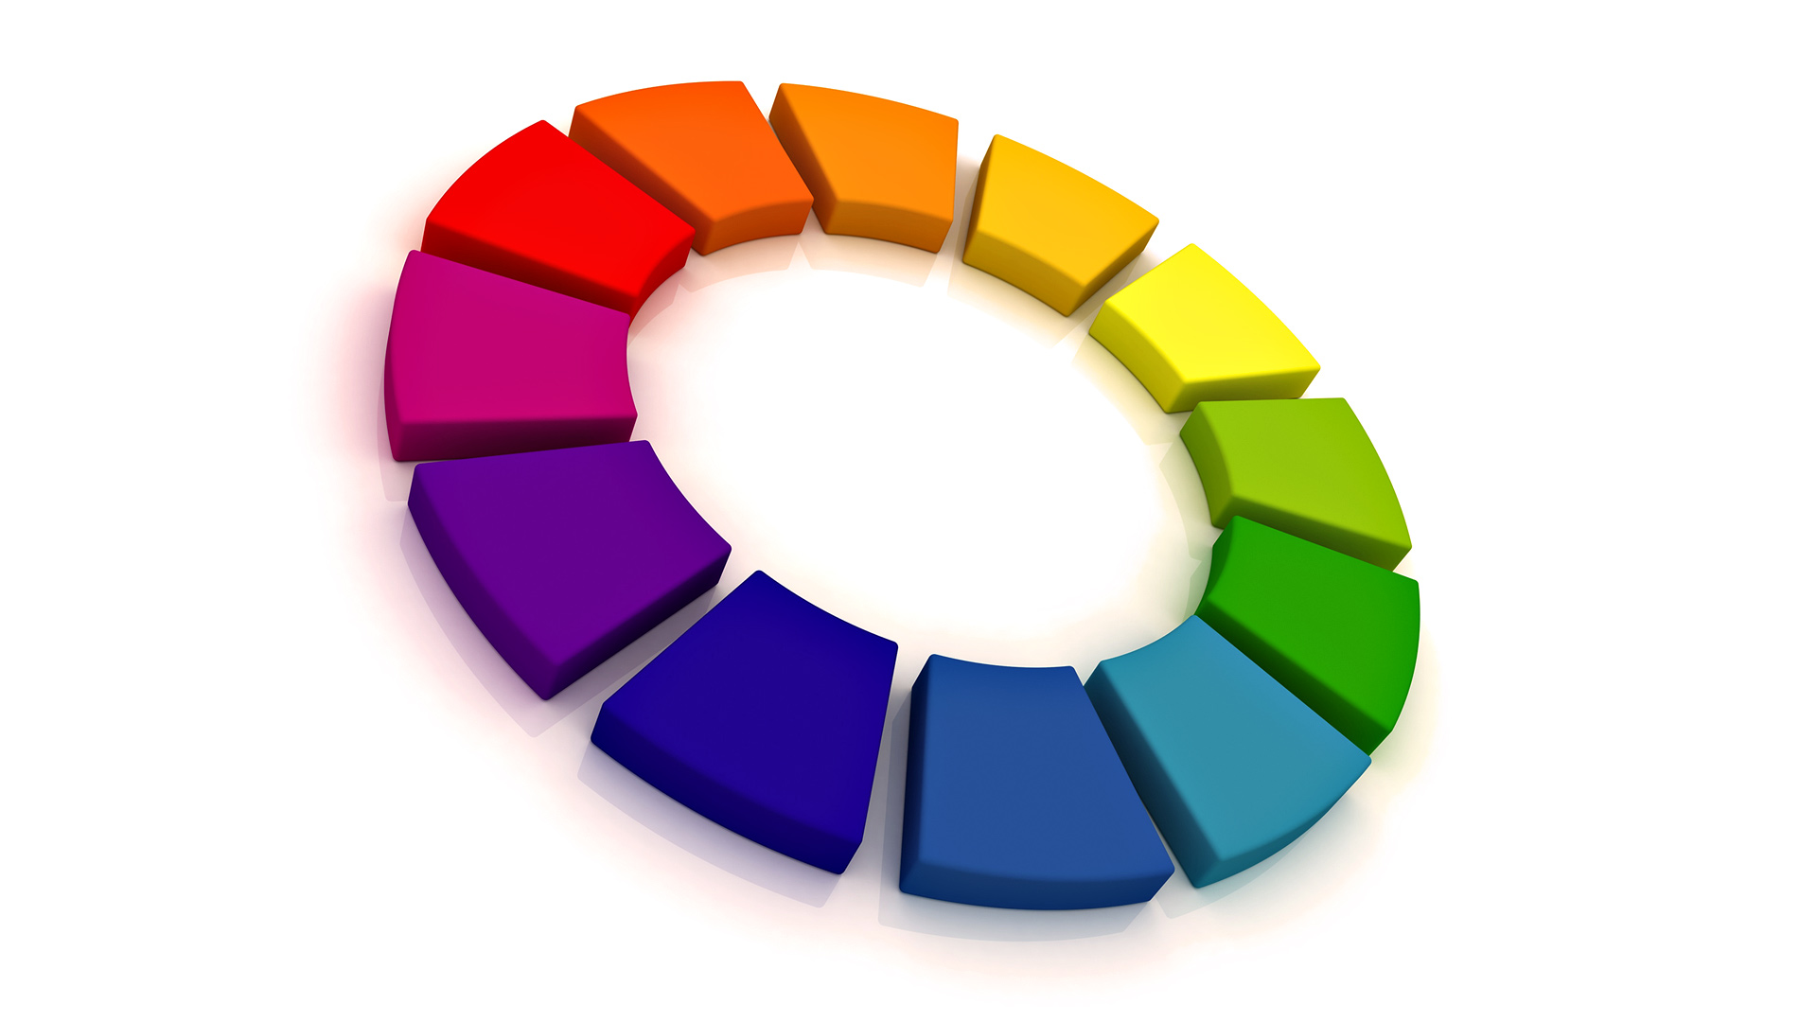
Throwaway vs Evolutionary Prototyping
Throwaway
Evolutionary
validate or derive the system requirements
discarded
Deliver a working system
Problems:
Structure is corrupted

Slide 24
Throwaway Prototyping
Prototyping in the software process may involve :
‘Throw-away' The objective of throw-away prototyping is to validate or derive the system requirements
It will be discarded once the requirement specs are specified
prototyping in which a prototype is developed to understand the system requirements, or
Evolutionary prototyping in which a prototype evolves through a number of versions to the final system

Slide 25
Evolutionary Prototyping
The objective of evolutionary prototyping is to deliver a working system to end-users
The principal problem with evolutionary prototyping is that the system structure becomes corrupted by constant change. Further changes to the system become increasingly difficult to make

Slide 26
Throwaway vs Evolutionary Prototyping
Evolutionary
Prototyping
Delivered system
Outline requirements
Throw-Away
Prototyping
Executable Prototype + System Specification

Slide 27

Throwaway vs Evolutionary Prototyping
Develop the parts you understand LEAST
Throw-Away Prototyping

Slide 28

Throwaway vs Evolutionary Prototyping
Develop the parts you understand BEST
Evolutionary Prototyping
Build very robust prototype in a structured manner & constantly refine it.
Minimize risk
Notes:
build a very robust prototype in a structured manner and constantly refine it.
In Evolutionary Prototyping, developers can focus themselves to develop parts of the system that they understand instead of working on developing a whole system.
To minimize risk, the developer does not implement poorly understood features. The partial system is sent to customer sites. As users work with the system, they detect opportunities for new features and give requests for these features to developers. Developers then take these enhancement requests along with their own and use sound configuration-management practices to change the software-requirements specification, update the design, recode and retest.^{[10]}

Slide 29
Benefits of Prototyping
Misunderstandings between software developers and users may be identified as the system functions are demonstrated
Missing user services may be detected
Software development staff may find incomplete and/or inconsistent requirements as the prototype is developed

Slide 30
Benefits of Prototyping
Difficult-to-use or confusing user services may be identified and refined
A working system, although incomplete is available quickly to demonstrate the feasibility and usefulness of the application to management
The prototype serves as a basis for writing the specification for a production quality system

Slide 31


Ince and Hekmatpour (1987) claim that prototype helps in:
User training
System testing – ‘back-to-back’ tests

Slide 32

Drawbacks of Prototyping
Planning, costing and estimating a prototyping project is outside the experience of many software project managers
Procedures for change and configuration management may be unsuitable for controlling the rapid change inherent in prototyping. However, if there are no change management procedures, evaluation is difficult.
Managers may exert pressure on prototype evaluators to reach swift conclusions about the prototype. These may result in inappropriate requirements.

Slide 33
Drawbacks of Prototyping
Customers demand “few fixes” to it to become the working version → low quality
Developers initially used familiar OS, algorithm, etc. which are not appropriate but to demonstrate system capability only. But in the end, forgot the reasons why they were inappropriate: hence did not use the better OS, algorithm, etc to develop end product.

Slide 34
Discussion
Common argument against prototyping is the cost may be too high. Why not ‘build it cheap and fix it later’ i.e. modify a finished system to meet unperceived needs?
Do you agree with such notion?

Slide 35

2. Prototyping Model
When to use prototyping approach?
Developers unsure of the efficiency of an algorithm
Developers unsure of the human/machine interaction that should take place

Slide 36
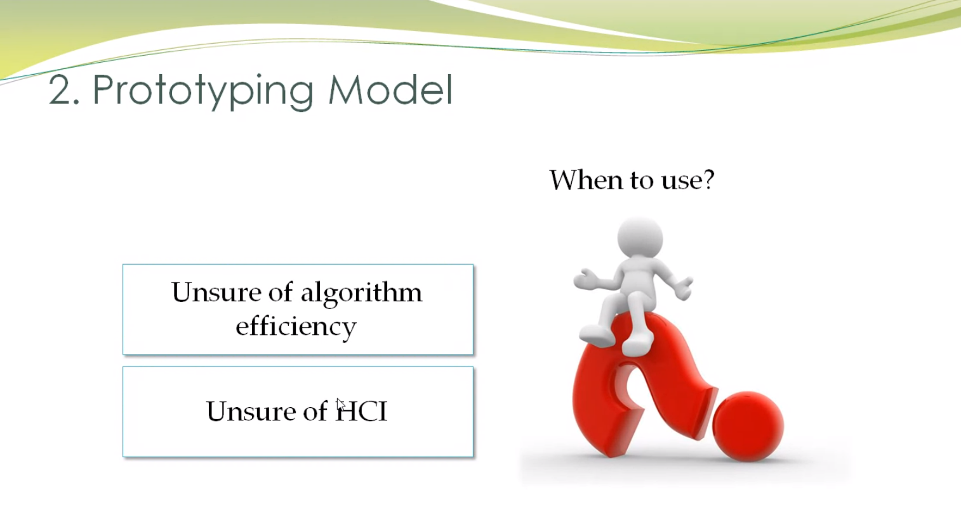

Slide 37
3. Rapid Application Development (RAD) Model

Slide 38
3. The RAD Model
Rapid Application Development
Which is an incremental software development process model that emphasizes an extremely short development cycle.

Slide 39


3. The RAD Model
Data Modeling
Business Modeling
e.g. ERD
Process Modeling
e.g. DFD, flowchart
RAD Activities
Testing & Turnover
Application Generation

Slide 40
3. The RAD Model
Activities include:
Business modeling : get to know the business procedures
Data modeling
Process modeling
Application generation: use 4th GL & reusable components
Testing and turnover

Slide 41
3. The RAD Model
More costly (because want the program in a short period of time)
More resources needed
Team # 1
Team # 2
Team # 3
Business
modeling
Business
modeling
Data
modeling
Data
modeling
Process
modeling
Application
generation
Process
modeling
Testing &
turnover
Application
generation
Testing &
turnover
60-90 days

Slide 42
3. The RAD Model
User requirements are well-known
When to use?
Project scope is well defined
High user involvement

Slide 43
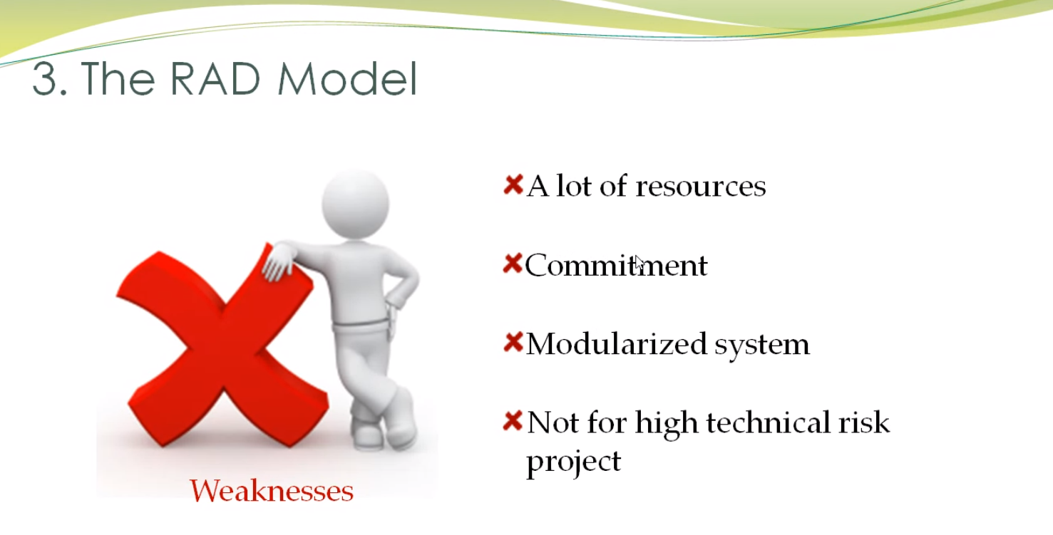
MUST

Slide 44
3. The RAD Model
What are the weaknesses of this model?
Need a lot of resources to create several teams
Users and developers must be committed to the rapid-fire necessary in this model
Appropriate only if the system can be modularized
Not suitable when technical risks are high. E.g. when developers are unfamiliar with new technology to be used in the software development

Slide 45
Exercise
 | Waterfall | Prototyping | RAD
Staff | Many staff (just assigned one team and finish the project) | Less/few staff (one team) | Most staff involved (one module one team)
Development time | Long | Short/long (depends on project) | Short
User involvement | Low | High | High
User Requirements | clear | Not clear | clear
Release | No intermediate release | Prototype | No intermediate release

Slide 46
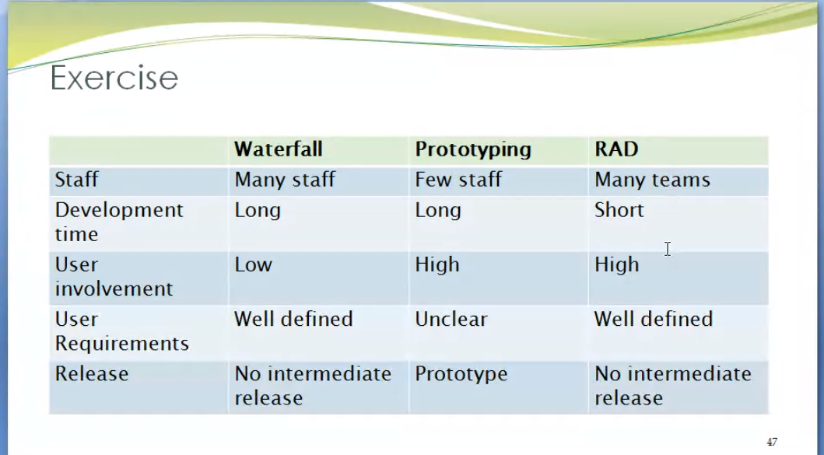

Slide 47
Evolutionary Software Process Model

Slide 48
Evolutionary Software Process Model
It is based on the idea of developing an initial implementation, exposing this to user comment and refining this through many versions until an adequate system has been developed.
These models are iterative. They are characterized in a manner that enables software engineers to develop increasingly more complete versions of the software.
Two common examples:
Incremental Model
Spiral Model

Slide 49
4. Evolutionary Software Process Model: Incremental Model

Slide 50
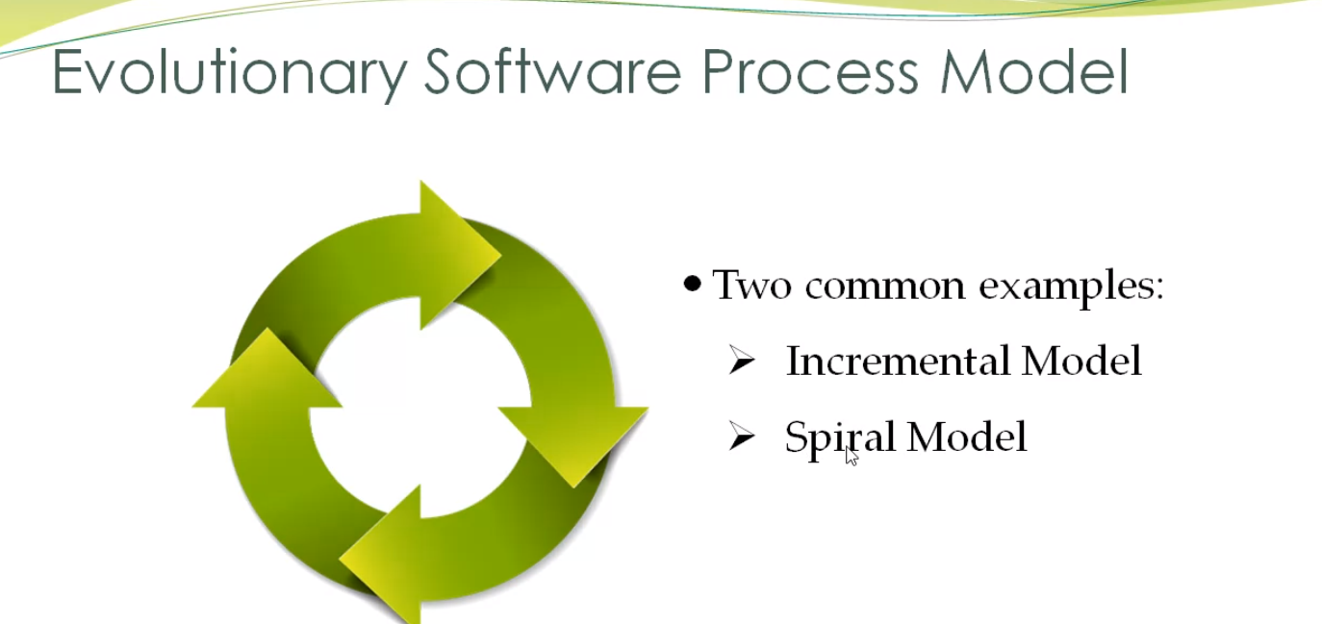

Slide 51
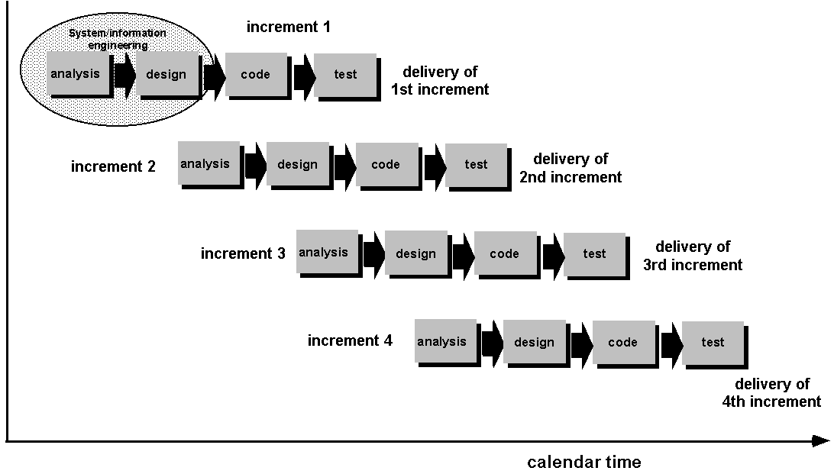
4. Evolutionary Software Process Model: Incremental Model

Slide 52
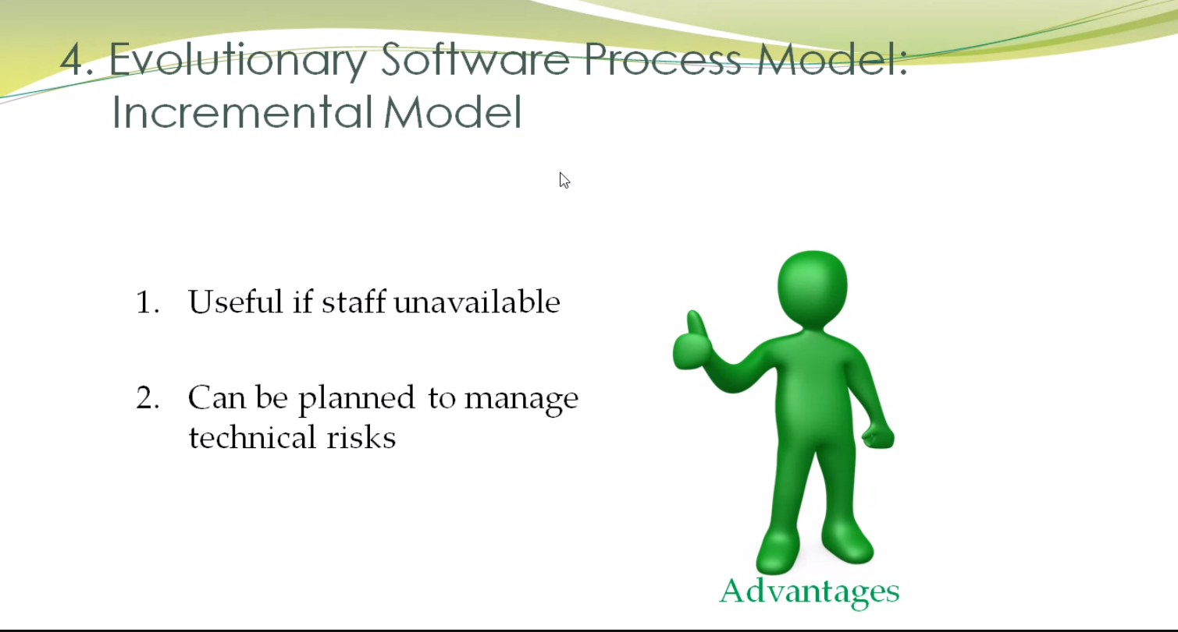

Slide 53
4. Evolutionary Software Process Model: Incremental Model
How it works?
Doing part by part, can make improvement based on each of the part in the project
Deliver the core product function(s)/feature(s) at the first increment/version and deliver the supplementary product function(s)/feature(s) in next increment(s)/version(s).

Slide 54
4. Evolutionary Software Process Model: Incremental Model
What are the advantages of this model?
Particularly useful if staff unavailable.
Can be planned to manage technical risks.
E.g. If the required h/w is not available at the early stage, plan not to use it in the early increment. So, able to deliver partial functionality to customer without delay!

Slide 55
4. Evolutionary Software Process Model: Incremental Model
What is the main difference between incremental model and RAD model?
RAD needs more resources to create several teams.
Incremental model needs less resources, project done by one team
Incremental model delivers software product version by version

Slide 56
5. Evolutionary Software Process Model: Spiral Model

Slide 57
5. Evolutionary Software Process Model: Spiral Model
Divided into a number of framework activities, called task regions.
Software engineering team moves around the spiral, beginning at the center.

Slide 58
5. Evolutionary Software Process Model: Spiral Model
planning
estimation
scheduling
risk analysis
communication
TASK REGION
modeling
analysis
design
start
deployment
construction
delivery
code
feedback
test

Slide 59
5. Evolutionary Software Process Model: Spiral Model Example
Planning
Estimate on time and cost needed
estimation
scheduling
risk analysis
Risk : Incomplete user requirement
communication
modeling
analysis
design
start
deployment
construction
delivery
code
feedback
test

Slide 60
5. Evolutionary Software Process Model: Spiral Model Example
Analyse facts gathered
planning
estimation
scheduling
risk analysis
communication
Modeling
analysis
design
start
deployment
construction
delivery
code
feedback
test

Slide 61
5. Evolutionary Software Process Model: Spiral Model Example
User requirements documentation
planning
estimation
scheduling
risk analysis
communication
modeling
analysis
design
start
deployment
Construction
delivery
code
feedback
test

Slide 62
5. Evolutionary Software Process Model: Spiral Model Example
Present user requirement to customers
planning
estimation
scheduling
risk analysis
communication
modeling
analysis
design
start
Deployment
construction
delivery
code
feedback
test

Slide 63
5. Evolutionary Software Process Model: Spiral Model Example
Discuss for detail requirements
planning
estimation
scheduling
risk analysis
Communication
modeling
analysis
design
start
deployment
construction
delivery
code
feedback
test

Slide 64
5. Evolutionary Software Process Model: Spiral Model Example
Adjust time and cost needed
Planning
estimation
scheduling
risk analysis
Risk : Lack of user involvement
communication
modeling
analysis
design
start
deployment
construction
delivery
code
feedback
test

Slide 65
5. Evolutionary Software Process Model: Spiral Model Example
Design prototype
planning
estimation
scheduling
risk analysis
communication
Modeling
analysis
design
start
deployment
construction
delivery
code
feedback
test

Slide 66
5. Evolutionary Software Process Model: Spiral Model Example
Prototype
planning
estimation
scheduling
risk analysis
communication
modeling
analysis
design
start
deployment
Construction
delivery
code
feedback
test

Slide 67
5. Evolutionary Software Process Model: Spiral Model Example
Present prototype & get feedback from customer
planning
estimation
scheduling
risk analysis
communication
modeling
analysis
design
start
Deployment
construction
delivery
code
feedback
test

Slide 68
5. Evolutionary Software Process Model: Spiral Model Example
Clarify the feedback and get more user requirements (if any)
planning
estimation
scheduling
risk analysis
Communication
modeling
analysis
design
start
deployment
construction
delivery
code
feedback
test

Slide 69
5. Evolutionary Software Process Model: Spiral Model Example
Adjust project plan
Planning
estimation
scheduling
risk analysis
Risk : User change their requirement
communication
modeling
analysis
design
start
deployment
construction
delivery
code
feedback
test

Slide 70
5. Evolutionary Software Process Model: Spiral Model Example
Analyse and design the new system
planning
estimation
scheduling
risk analysis
communication
Modeling
analysis
design
start
deployment
construction
delivery
code
feedback
test

Slide 71
5. Evolutionary Software Process Model: Spiral Model Example
Prepare the Analysis and design models, e.g. DFD, ERD
planning
estimation
scheduling
risk analysis
communication
modeling
analysis
design
start
deployment
Construction
delivery
code
feedback
test

Slide 72
5. Evolutionary Software Process Model: Spiral Model Example
Present models to users
planning
estimation
scheduling
risk analysis
communication
modeling
analysis
design
start
Deployment
construction
delivery
code
feedback
test

Slide 73
5. Evolutionary Software Process Model: Spiral Model
Advantage : Risk Management
During each iteration through the process steps, both the technical and management risks are assessed to see if it is still possible to complete the project which its required functionality with acceptable time and cost constraints.

Slide 74
6. Component-based Development

Slide 75
6. Component-based Development
OO Technologies provide the technical framework for a component-based process model for software engineering.
This model assumes that parts of the system already exist.

Slide 76
6. Component-based Development
Construct nth iteration of system
Identify candidate components
Put new components in library
Look up components in library
Build components if unavailable
Extract components if available

Slide 77
6. Component-based Development
It focuses on integrating these parts rather than developing them from scratch
Hence, this model leads to software reuse
Note : Discuss more detail in later chapter - CBSE.
Advantages

Slide 78
7. Agile Software Development

Slide 79
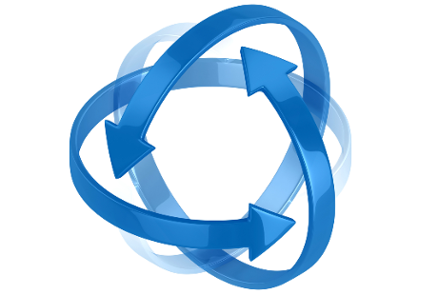
7. Agile Software Development
Increment available in 2-3 weeks
Incremental & Iterative
Agile
Requirement changing
Minimal documentation
Cross functional team
Iterations with short timeframe

Slide 80
7. Agile Software Development
Each iteration:
Working product
Review
Agile

Slide 81
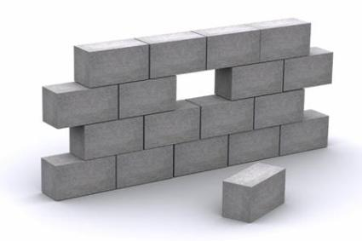







7. Agile Software Development
Analysis
Develop
Sprint (Iteration)
Test
“To-do” list or Product Backlog
Iteration
Sprint Backlog
Client and stakeholders:
Review increment
Plan for next iteration
Working software

Slide 82
7. Agile Software Development
Twelve Agility Principles
Customer satisfaction
Welcome changing requirements
Working software is delivered frequently
Working software is the principal measure of progress
Sustainable development
Close, daily co-operation between business people and developers
Working software

Slide 83

7. Agile Software Development
Twelve Agility Principles
Face-to-face conversation
Motivated individuals
Attention to technical excellence and good design
Simplicity
Self-organizing teams
Regular adaptation to changing circumstances

Slide 84
7. Agile Software Development
Plan-Driven vs. Agile Development
Agile Approach | Plan-Driven Approach
Consider design and implementation to be the central activities and thus incorporate requirements elicitation and testing into design and implementation | Identifies separate stages in the software process with outputs associated with each stage.

Slide 85
7. Agile Software Development
Plan-Driven vs. Agile Development
Agile Approach | Plan-Driven Approach
Iteration occurs across activities. Therefore, the requirements and the design are developed together, rather than separately | Iteration occurs within activities with formal documents used to communicate between stages of the process. E.g. requirements will evolve then a requirements specification will be produced as input to the design and implementation process.

Slide 86
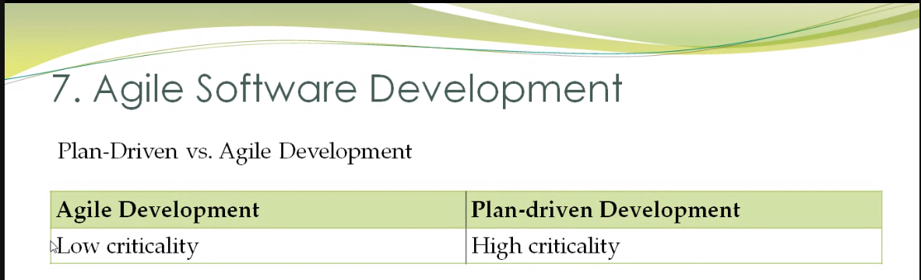
7. Agile Software Development
Plan-Driven vs. Agile Development
Agile Approach | Plan-Driven Approach
Might produce some design documentation. | Support incremental development and delivery. It is feasible to allocate requirements and plan the design and development phase as a series of increments. E.g. incremental model, spiral model

Slide 87
7. Agile Software Development
Plan-Driven vs. Agile Development
Agile Development | Plan-driven Development
Low criticality | High criticality
Agile Development | Plan-driven Development
Low criticality | High criticality
Senior developers | Junior developers
Agile Development | Plan-driven Development
Low criticality | High criticality
Senior developers | Junior developers
Requirements change often | Requirements do not change often
Agile Development | Plan-driven Development
Low criticality | High criticality
Senior developers | Junior developers
Requirements change often | Requirements do not change often
Small number of developers | Large number of developers
Agile Development | Plan-driven Development
Low criticality | High criticality
Senior developers | Junior developers
Requirements change often | Requirements do not change often
Small number of developers | Large number of developers
Culture that responds to change | Culture that demands order

Slide 88
7. Agile Software Development
Most software projects include practices from both plan-driven and agile approaches.

Slide 89

Exercise
In each of the following consideration, decide which approach (Agile Software Development or Plan-driven Development) is most appropriate.
Is it important to have a very detailed specification and design before moving to implementation? Plan-driven Development
Is an incremental delivery strategy, where you deliver the software to customers and get rapid feedback from them, realistic? Agile Software Development

Slide 90
Exercise
In each of the following consideration, decide which approach (Agile Software Development or Plan-driven Development) is most appropriate.
How large is the system?
What type of system?
What is the expected system lifetime?
What technologies are available?

Slide 91
Exercise
In each of the following consideration, decide which approach (Agile Software Development or Plan-driven Development) is most appropriate.
How is the development team organized?
Are there cultural issues? Agile no
How good are the designers/programmers? Agile must very expert and good experience
Is the system subject to external regulation? For agile no

Slide 92
8. Extreme Programming

Slide 93
8. Extreme Programming
Focus on programming
Extreme Programming (XP) is one of the well-known agile software development methods.
The name was coined by Beck (2000)

Slide 94
8. Extreme Programming
Select user stories for this release
Break down stories to tasks
Plan release
Evaluate system
Release software
Develop/ integrate/ test software
The XP release cycle
Notes:
This figure illustrates the XP process to produce an increment of the system that is being developed.
In XP, requirements are expressed as scenarios (called user stories), which are implemented directly as a series of tasks. Programmers work in pairs and develop tests for each task before writing the code. All tests must be successfully executed when new code is integrated into the system. There is a short time gap between releases of the system.
An example of user story template based on the Five Ws specifies:
"As <who> <when> <where>, I <what> because <why>.“
e.g. search for customer: As a user, I want to search for my customers by their first and last names.

Slide 95

8. Extreme Programming
Incremental planning
Small releases
Simple design
Test-first development
Refactoring
Refer Sommerville, figure 3.4, pg 66 for explanation
Notes:
Incremental planning – requirements are recorded on Story Cards and the Stories to be included in a release are determined by the time available and their relative priority. The developers break these Stories into development ‘Tasks’.
Small releases – the minimal useful set of functionality that provides business value is developed first. Releases of the sys are frequent and incrementally add functionality to the first release.
Simple design – enough design is carried out to meet the current requirements and no more.
Test-first development – an automated unit test framework is used to write tests for a new piece of functionality before that functionality itself is implemented.
Refactoring – all developers are expected to refactor the code continuously as soon as possible code improvements are found. This keeps the code simple and maintainable.
Pair programming – developers work in pairs, checking each other’s work and providing the support to always do a good job.
Collective ownership – the pairs of developers work on all areas of the system, so that no islands of expertise develop and all the developers take responsibility for all of the code. Anyone can change anything.
Continuous integration – as soon as the work on a task is complete, it is integrated into the whole system. After any such integration, all the unit tests in the system must pass.
Sustainable pace – large amounts of overtime are not considered acceptable as the net effect is often reduce code quality and medium term productivity.
On-site customer – a representative of the end-user of the system (the Customer) should be available full time for the use of the XP team. In an XP process, the customer is a member of the development team and is responsible for bringing sys requirements to the team for implementation.

Slide 96
8. Extreme Programming
Pair programming
Collective ownership
Continuous integration
Sustainable pace
On-site customer
Refer Sommerville, figure 3.4, pg 66 for explanation
Notes:
Incremental planning – requirements are recorded on Story Cards and the Stories to be included in a release are determined by the time available and their relative priority. The developers break these Stories into development ‘Tasks’.
Small releases – the minimal useful set of functionality that provides business value is developed first. Releases of the sys are frequent and incrementally add functionality to the first release.
Simple design – enough design is carried out to meet the current requirements and no more.
Test-first development – an automated unit test framework is used to write tests for a new piece of functionality before that functionality itself is implemented.
Refactoring – all developers are expected to refactor the code continuously as soon as possible code improvements are found. This keeps the code simple and maintainable.
Pair programming – developers work in pairs, checking each other’s work and providing the support to always do a good job.
Collective ownership – the pairs of developers work on all areas of the system, so that no islands of expertise develop and all the developers take responsibility for all of the code. Anyone can change anything.
Continuous integration – as soon as the work on a task is complete, it is integrated into the whole system. After any such integration, all the unit tests in the system must pass.
Sustainable pace – large amounts of overtime are not considered acceptable as the net effect is often reduce code quality and medium term productivity.
On-site customer – a representative of the end-user of the system (the Customer) should be available full time for the use of the XP team. In an XP process, the customer is a member of the development team and is responsible for bringing sys requirements to the team for implementation.

Slide 97
Software Process Model
Linear Sequential Model/Waterfall Model
Prototyping Model
Rapid Application Model
Evolutionary Model
Incremental Model
Spiral Model
Component-based Development Model
Agile Software Development
Extreme Programming

Slide 98
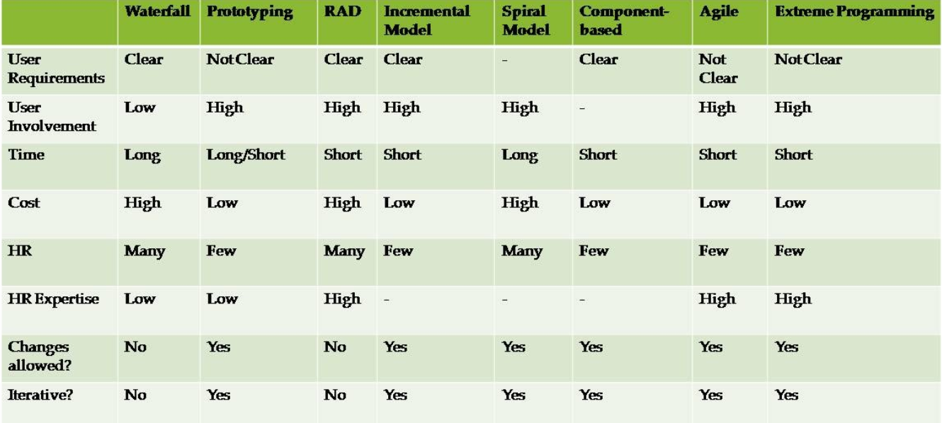
Exercise

Slide 99
Exercise
The software organization you are working with has recently successfully bid for a project to develop an e-learning system for a local established college. You are being assigned as a project manager to lead a project team of 12 members to handle this project.
During the requirement analysis stage, you found out that some of the requirements have not confirmed and finalized by your client. Furthermore, some of the hardware needed to develop certain parts of the system have to order from oversea vendors and they cannot promise the availability of these hardware in the early stage of development. However, your client wants the confirmed areas of the system to be delivered within two months time so that they can use this new system as part of the marketing strategies for the coming new academic intake.
Recommend an appropriate process model you would use to manage the above project. Justify your selection. You may state any assumptions to support your answer.

